Slide 2
Objectives
Understand the need for and purpose of encryption when transmitting data
Understand how data is encrypted using symmetric and asymmetric encryption

Slide 3
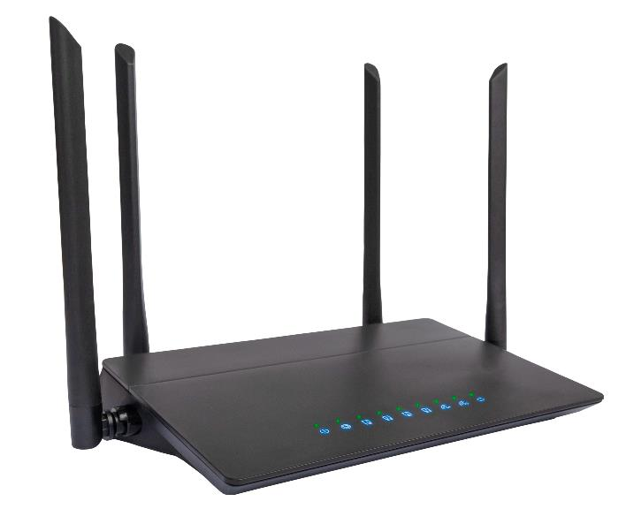
Starter
Many people now use a Wi-Fi access point in their home
Why do Wi-Fi access points need encryption?
Describe how the encryption on a Wi-Fi access point works from a user’s point of view

Slide 4
Starter
Why do Wi-Fi access points need encryption?
Sensitive data, such as passwords, bank information and photos, is sent from computers and devices to the access point
An eavesdropper can listen to the Wi-Fi signal and if it isn’t encrypted, they will be able to use this sensitive information
Describe how the encryption on a Wi-Fi access point works from a user’s point of view
A Wi-Fi password known as a pre-shared key (PSK) is given to each user that wants to connect to the network
The data is then encrypted using this key

Slide 5
The need for encryption
Large amounts of personal data are now stored and transmitted on computers
Companies and other organisations also have highly confidential data that they don’t want others looking at
In paper systems, sensitive data was held in locked cabinets and locked rooms
Now, sensitive data is often transmitted via the Internet which is a public network
Data is also stored on computers and servers on the Internet which may be hacked
If a hacker gains access to the data, they won’t be able to understand it if it is encrypted

Slide 6

What is encryption?
The purpose of encryption is to encode a file or data into something that cannot be read or understood
The file or data that cannot be understood is known as encrypted
A key or password is used to decrypt the data
“That’s one small step for a man, one giant leap for mankind.” – Neil Armstrong
AI94KkmC39g7c0xznwejg8sJKY37c3GBmOWp9DKcnbuenJhnDko94ncC385C7djkIolkfyvnwIHH9WI
Plaintext
Encrypted

Slide 7



Symmetric encryption
In symmetric encryption, a key is first shared between the sender and receiver
This key encrypts the data before it is transmitted
The receiver uses the key to decrypt the data
Sender
Receiver
The quick brown fox jumps over the lazy dog.
idEug94jvMzpr0UtjdnkcibntTD031BnZinIpPdkfi82nBnw
The quick brown fox jumps over the lazy dog.
Plaintext
Encrypted text
Plaintext
Secret shared key
Secret shared key

Slide 8
Symmetric encryption uses
The pre-shared key used to connect to a Wi-Fi access point makes use of symmetric encryption
Other uses for symmetric encryption include:
Adding a password to a ZIP file which also encrypts the file
Encrypting a hard drive or external storage device

Slide 9
Worksheet 4
Complete Task 1 on Worksheet 4

Slide 10


Asymmetric encryption
In asymmetric encryption, two keys are created by the receiver
The public key is accessible by anyone and used to encrypt data
The private key is kept secret by the receiver and used to decrypt the data
The technique is also known as public-key cryptography
This means that anyone can encrypt the data, but only the receiver can decrypt it
There is no need to share a secret key as happens with symmetric encryption

Slide 11


Asymmetric encryption
Both keys are generated by the receiver
Only the public key is shared with the sender
Public key
Private key
Sender
Receiver
The quick brown fox jumps over the lazy dog.
idEug94jvMzpr0UtjdnkcibntTD031BnZinIpPdkfi82nBnw
The quick brown fox jumps over the lazy dog.
Plaintext
Encrypted text
Plaintext

Slide 12
Web asymmetric encryption
Web pages that are shared using HTTPS (Hypertext transfer protocol secure) make use of encryption
The encryption used is asymmetric encryption
The browser and server share the necessary public keys to encrypt the data
They then use their private keys to decrypt the data
If symmetric encryption were used, every website you visit would first need to send the password privately to you – for instance through a letter
The sharing of a public key happens in a fraction of a second and there is no risk if an eavesdropper discovers it

Slide 13
Worksheet 4
Complete Task 2 on Worksheet 4

Slide 14
Plenary
Explain to a partner the following terms:
Encryption
Asymmetric
Encryption
Symmetric Encryption
Shared key
Public key
Private key
Decrypt
Encrypt
Plaintext

Slide 15
Plenary
Encryption – the process of encoding data in such a way that it becomes unreadable
Asymmetric encryption – a public key is used to encrypt the data; a private key is used to decrypt the data
Symmetric encryption – a private shared key is used to encrypt and decrypt the data
Shared key – the secret key that is used to encrypt and decrypt the data
Public key – a key that anyone may see and use to encrypt data before it is sent to someone
Private key – the key used to decrypt data
Decrypt – decode encrypted data back into plaintext
Encrypt – encode data into an unreadable form
Plaintext – text that hasn’t been encrypted

